Slide 1
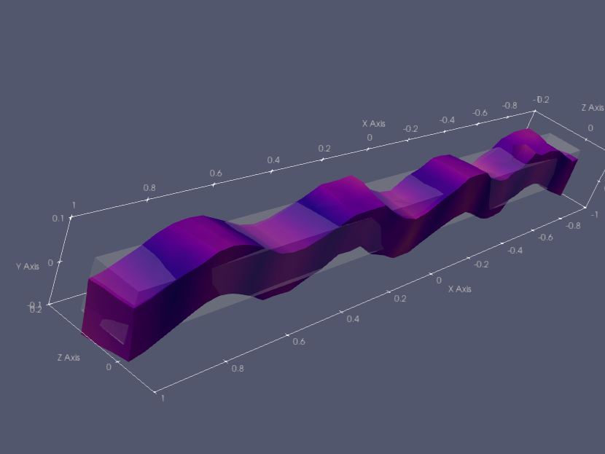
ParaView Workshop
Jonas Lindemann, LUNARC
Based in part on slides and data sets by
Mike Bailey Oregon State University
Mike Bailey's ParaView Page (oregonstate.edu)

Slide 2

InfraVis ParaView workshop
This is a participatory workshop
You should have received links to the material and download links for ParaView
I will present ParaView in a way that you can follow along
If you want to actively participate please have ParaView running and have the examples in the Mike_Bailey folder available.
It is perfectly ok to follow along passively

Slide 3

InfraVis ParaView workshop
ParaView is complex application
We will not have time to cover all functionality
I will try to convey the workflow of the application
A starting point for further work

Slide 4

Downloads and data files
Data files are available here:
https://github.com/jonaslindemann/paraview-workshop
ParaView can be downloaded here
https://www.paraview.org/download/
Download the stable version, currently 5.10

Slide 5
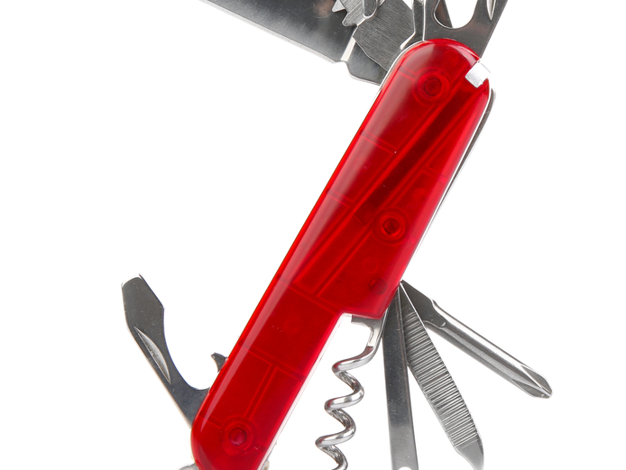
What is ParaView?
Tool for visualising data
Tool for analysing and data mining
A scripting based visualisation tool
Parallel visualisationa application for large scale visualisation
In-situ visualisation tool
”Swiss army knife of visualisation”

Slide 6
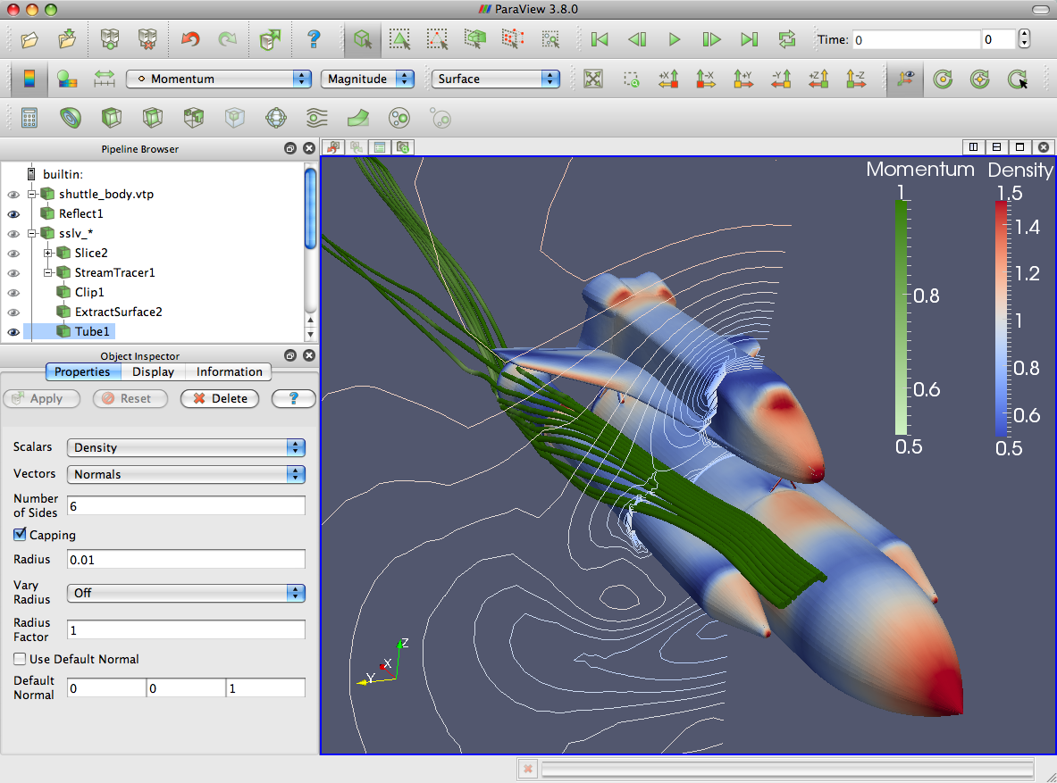
ParaView Application Architecture
ParaView Client
pvpython
ParaWeb
Catalyst
Custom App
UI (Qt Widgets, Python Wrappings)
ParaView Server
VTK
OpenGL
MPI
IceT
Etc.

Slide 7
ParaView Development
Started in 2000 as collaborative effort between Los Alamos National Laboratories and Kitware Inc. Sandia has been a major contributor since 2005.
ParaView 0.6 released October 2002.
Paraview 3.0 release in May 2007.
GUI rewritten to be more user friendly and powerful.
ParaView 4.0 released in June 2013.
Properties panel redesign for smoother interaction.
ParaView 5.0 released in January 2016.
Updated to OpenGL 3.2 features. Huge performance improvements.

Slide 8
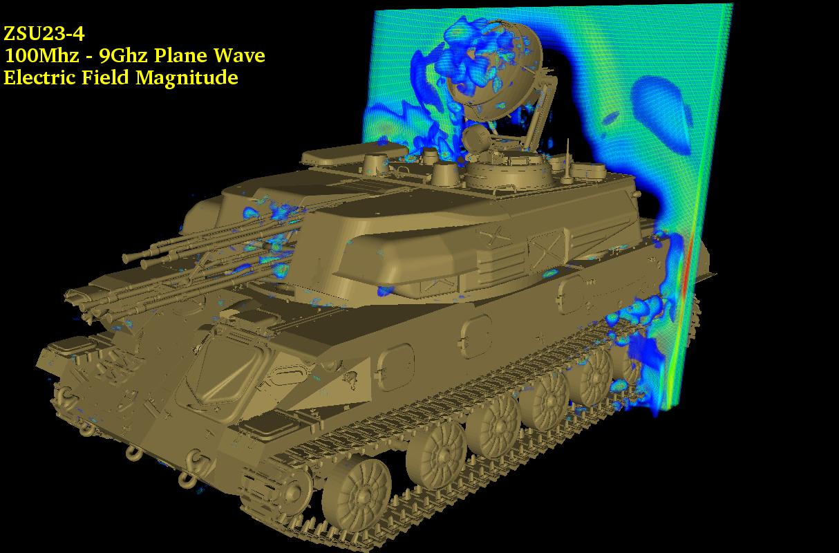
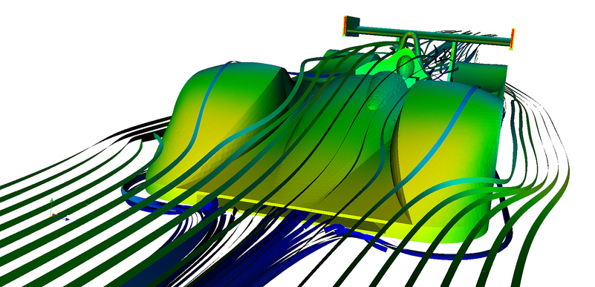
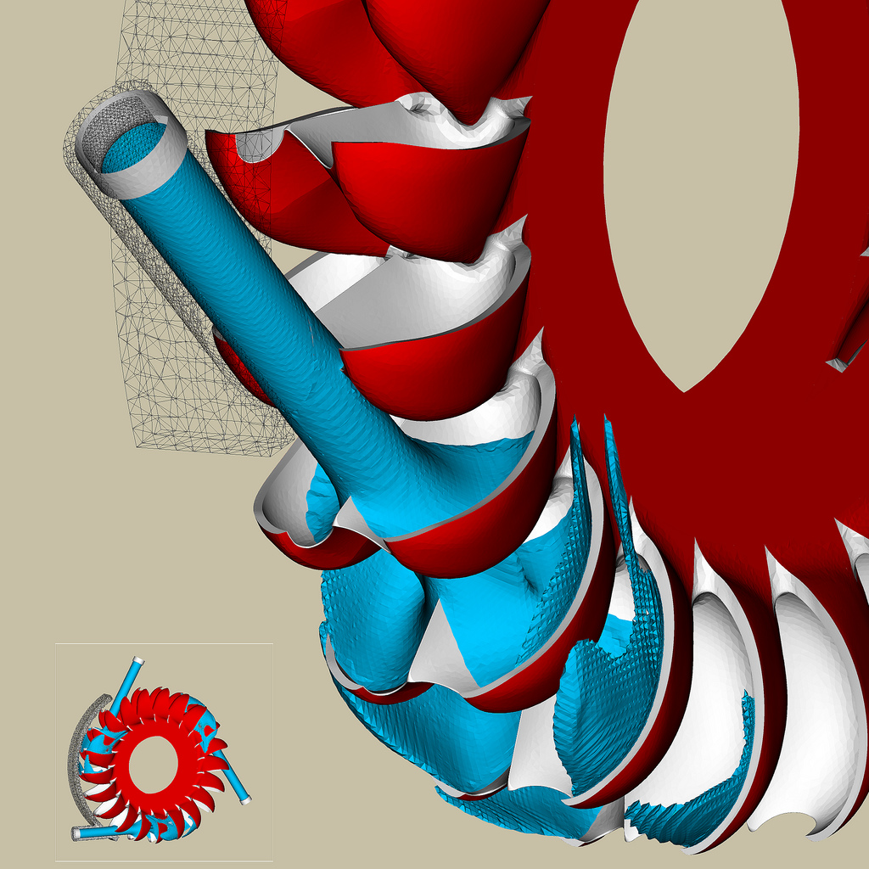
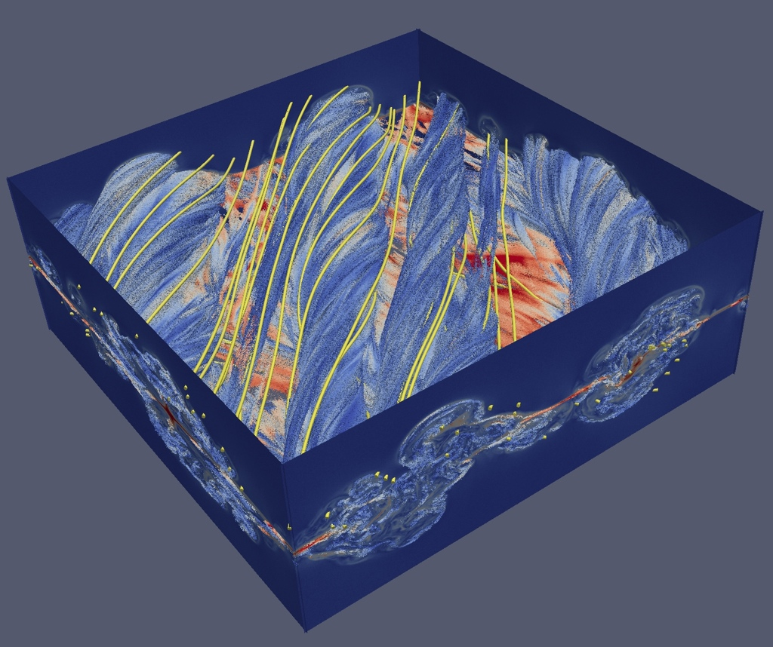
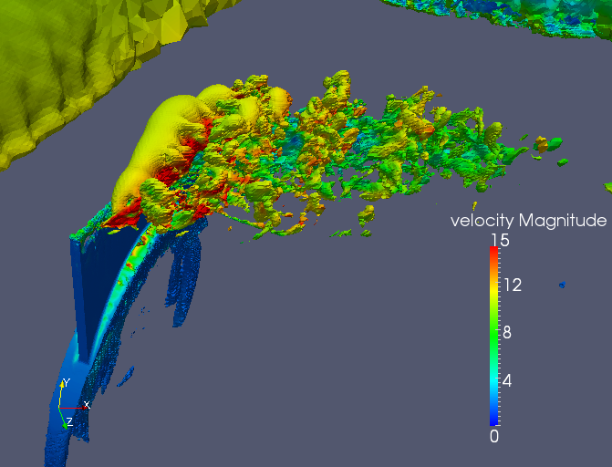
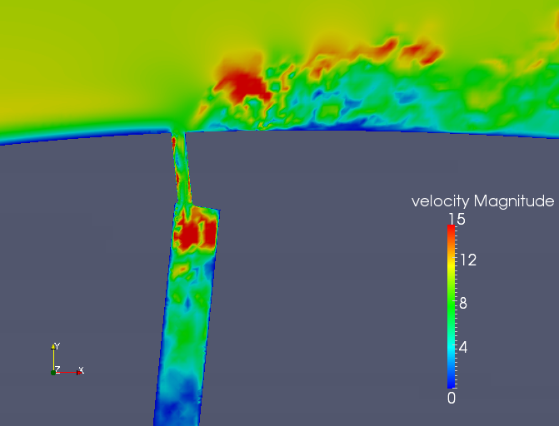
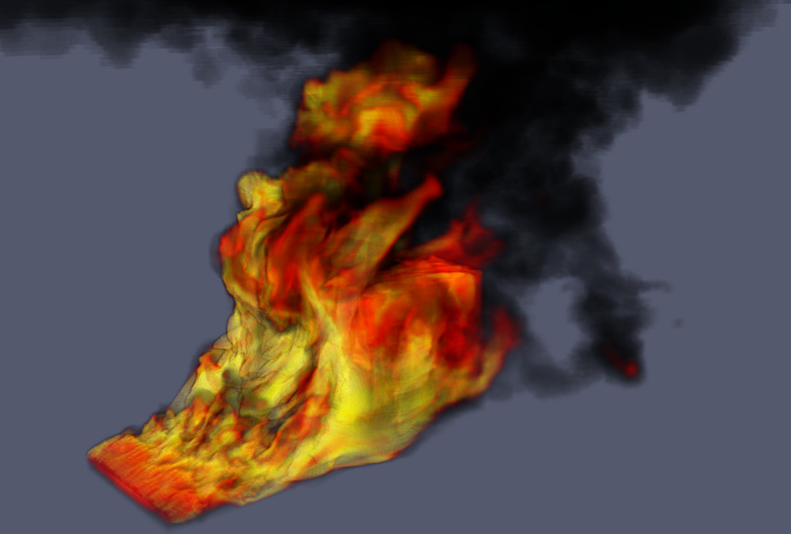
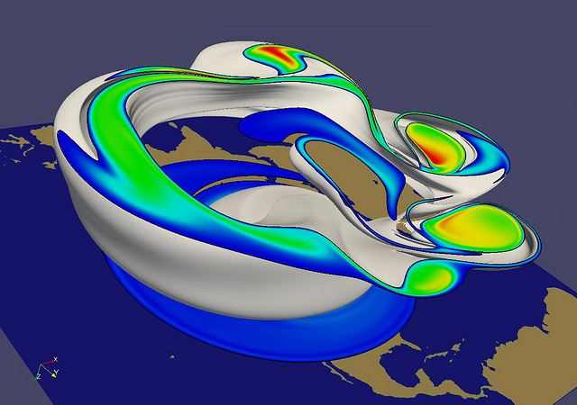
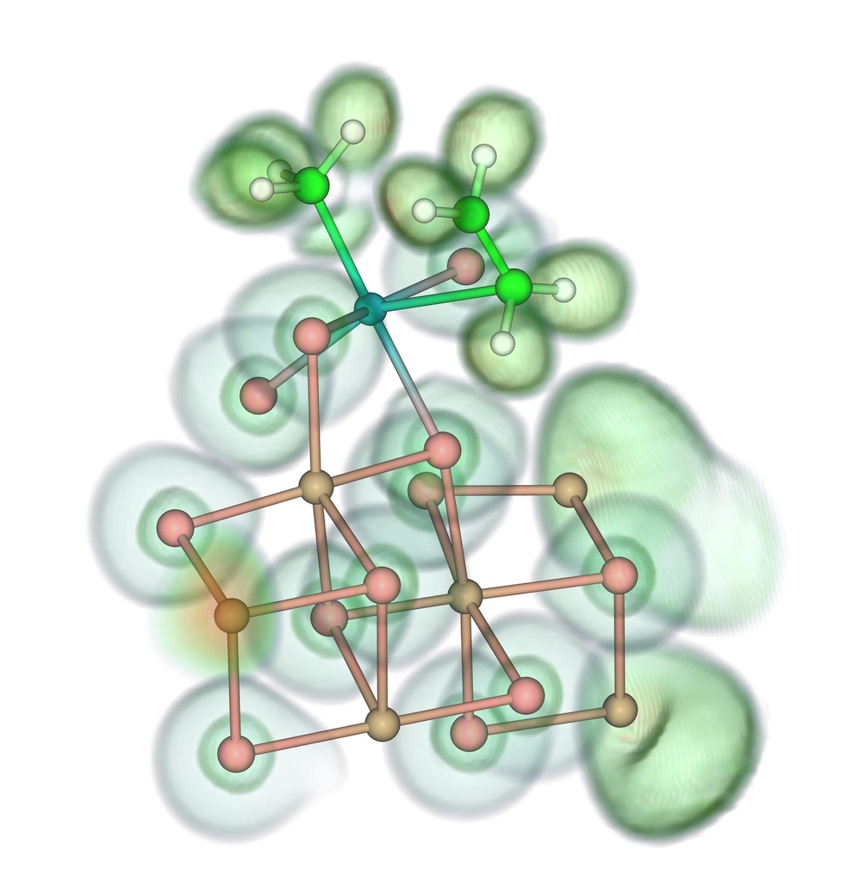
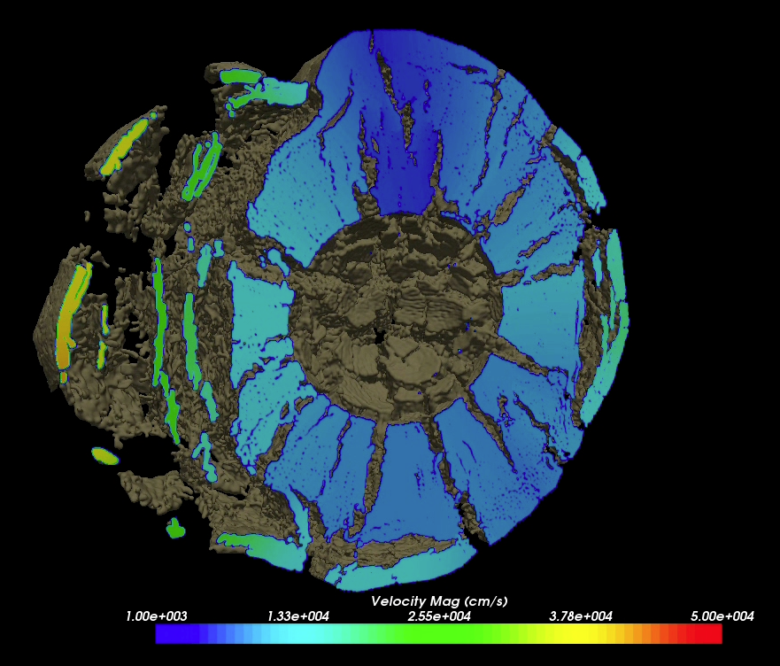
Renato N. Elias, NACAD/COPPE/UFRJ, Rio de Janerio, Brazil
Jerry Clarke, US Army Research Laboratory
Swiss National Supercomputing Centre
Bill Daughton, LANL
Swiss National Supercomputing Centre
Notes:
Small montage of projects using ParaView.
Demonstrates the breadth of utility ParaView has.

Slide 9
Basic concept
Visualisation application developmed by KitWare
Uses the Visualisation ToolKit (VTK) as foundation
Uses a flow concept for generating visualisations
Source
Filter
Filter
View
Filter

Slide 10
Data structures and data
RectilinearGrid
Vectors
Scalars
Vectors
Scalars
PointData
CellData

Slide 11
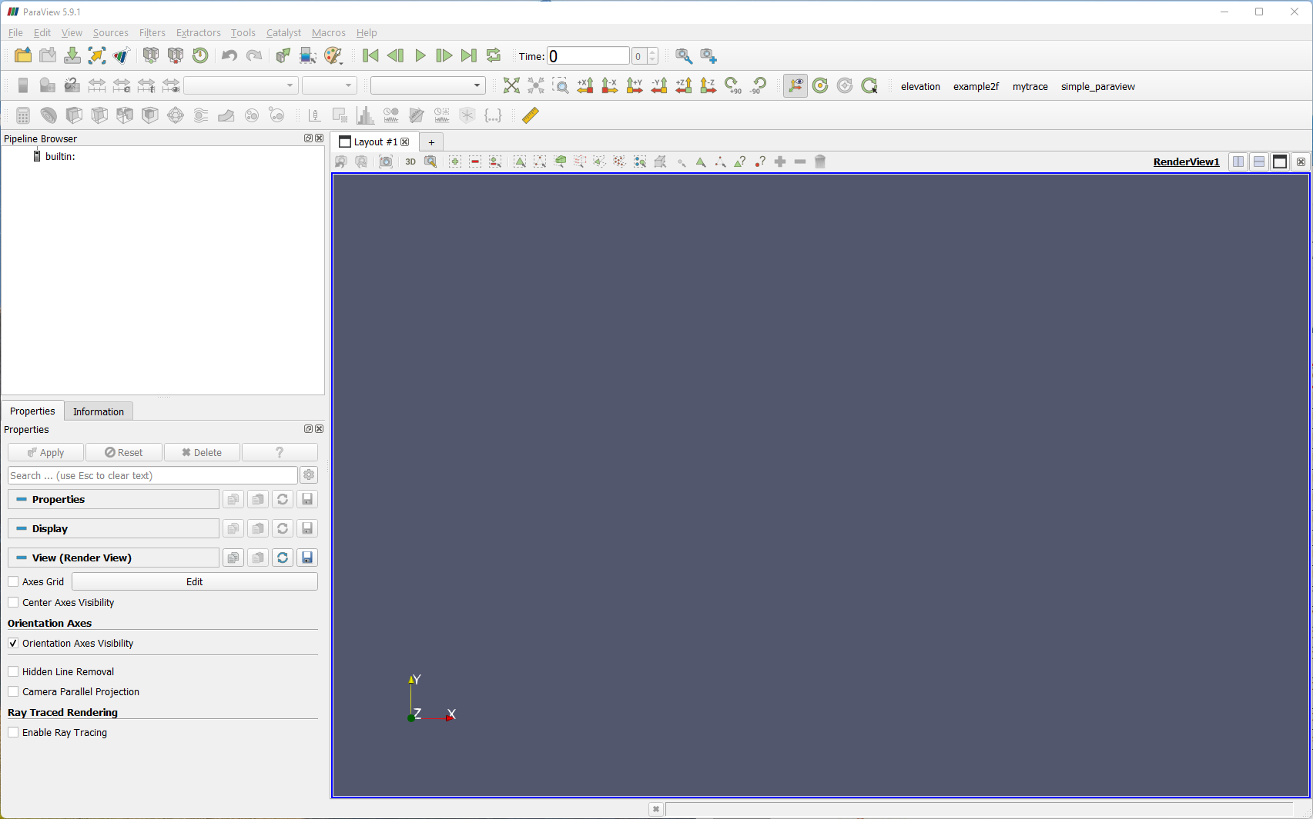
ParaView user interface
Reset visualisation
Animation control
Common filters
View control
Pipeline
Render View
Properties

Slide 12
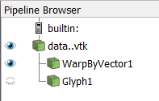
Flow in ParaView
Source data
Visibility of object
Filters

Slide 13
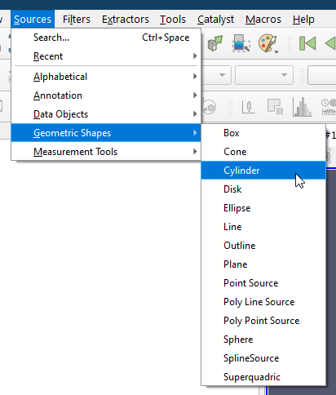
Basic usage – Creating a source

Slide 14
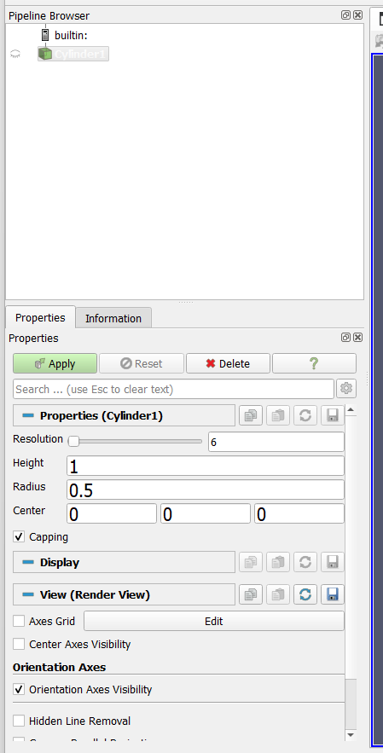
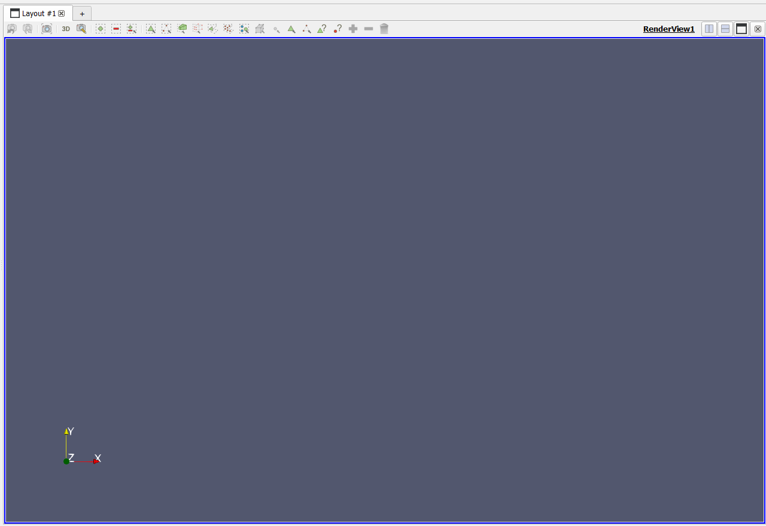
Creating a Cylinder
Cylinder source
Generate output
No output!

Slide 15
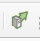
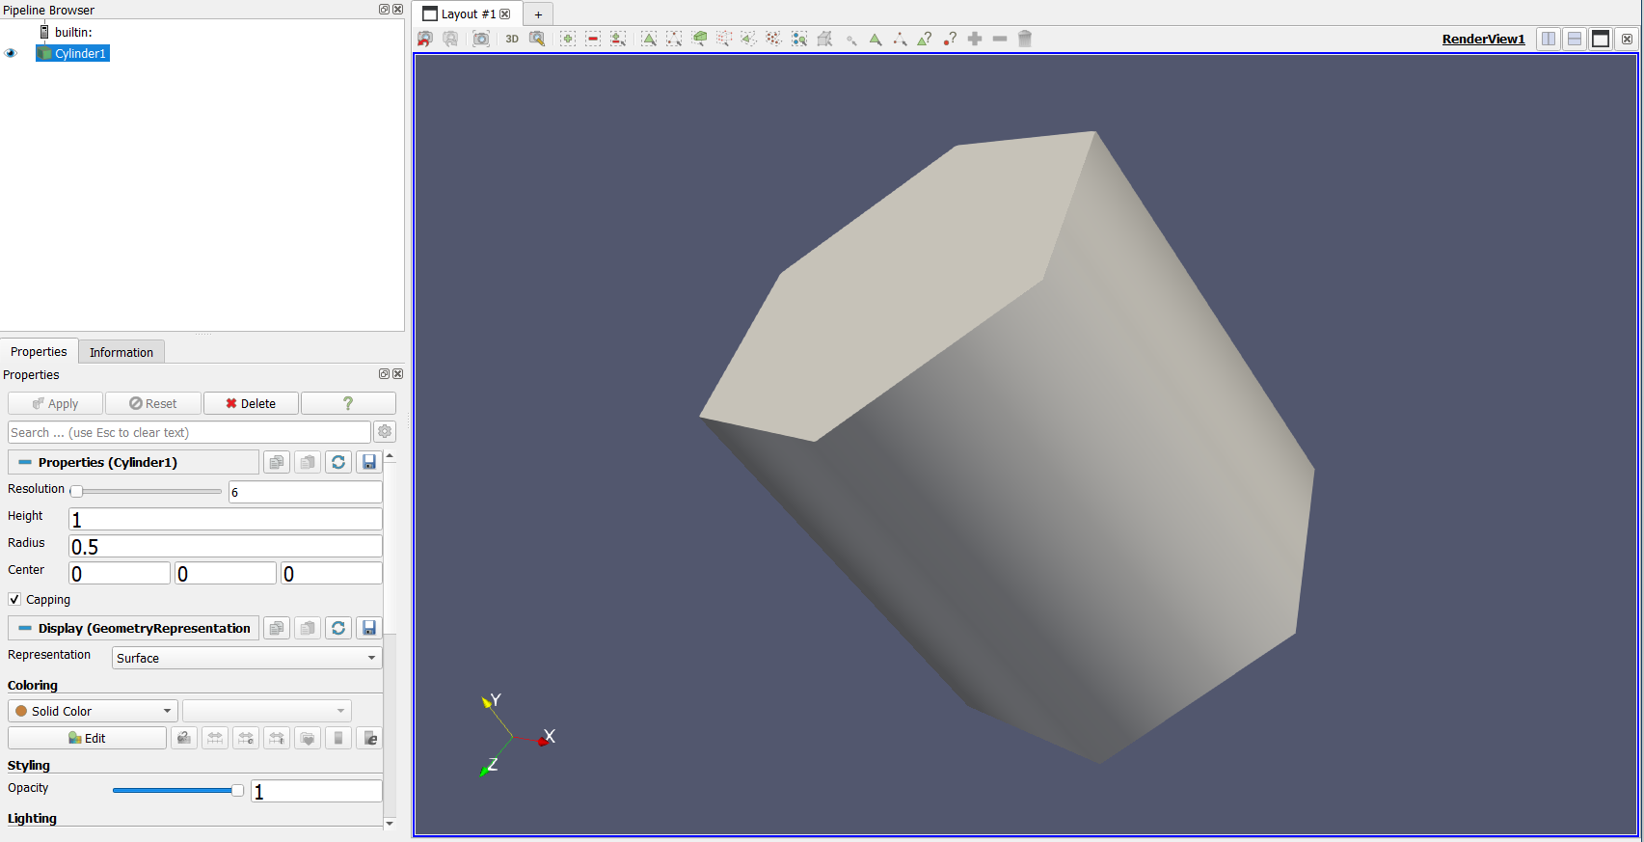
Creating a Cylinder
Enables auto-apply. Can be costly in some operations.
No visualisations are displayed until the Apply button is pressed.

Slide 16

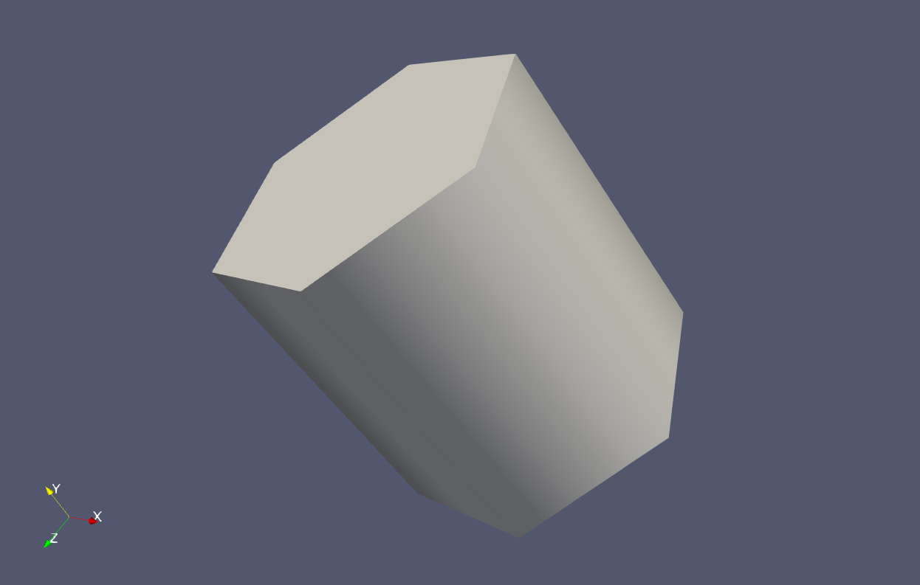

3D view manipulation
Rotate view

Slide 17
3D view manipulation
Shift
Roll view

Slide 18




3D view manipulation
Pan

Slide 19

3D view manipulation
Zoom in / Zoom out

Slide 20
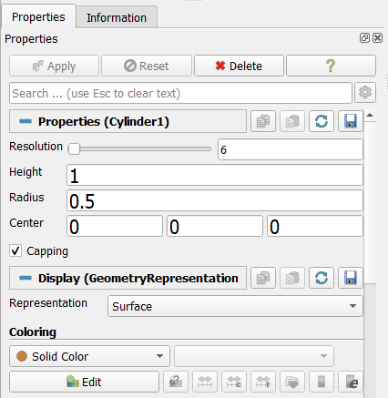
Specific object properties
All objects in ParaView have properties that can be changed in the property inspector.
For the Cylinder this is resolution, height, radius, capping.

Slide 21
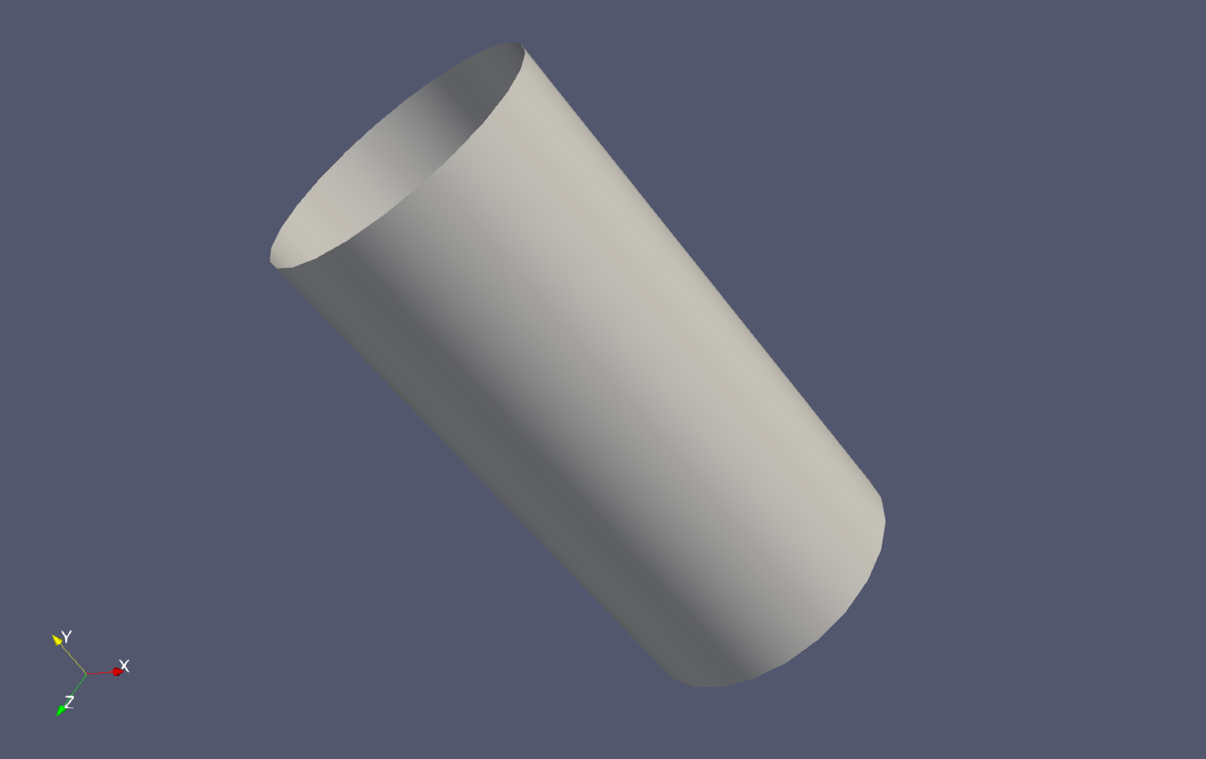
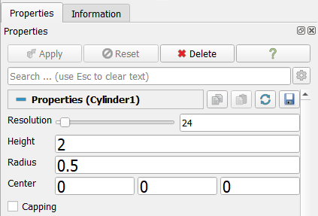
Specific object properties
Don’t forget to press apply after a change or use the auto-apply button

Slide 22
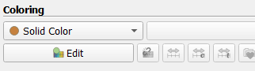
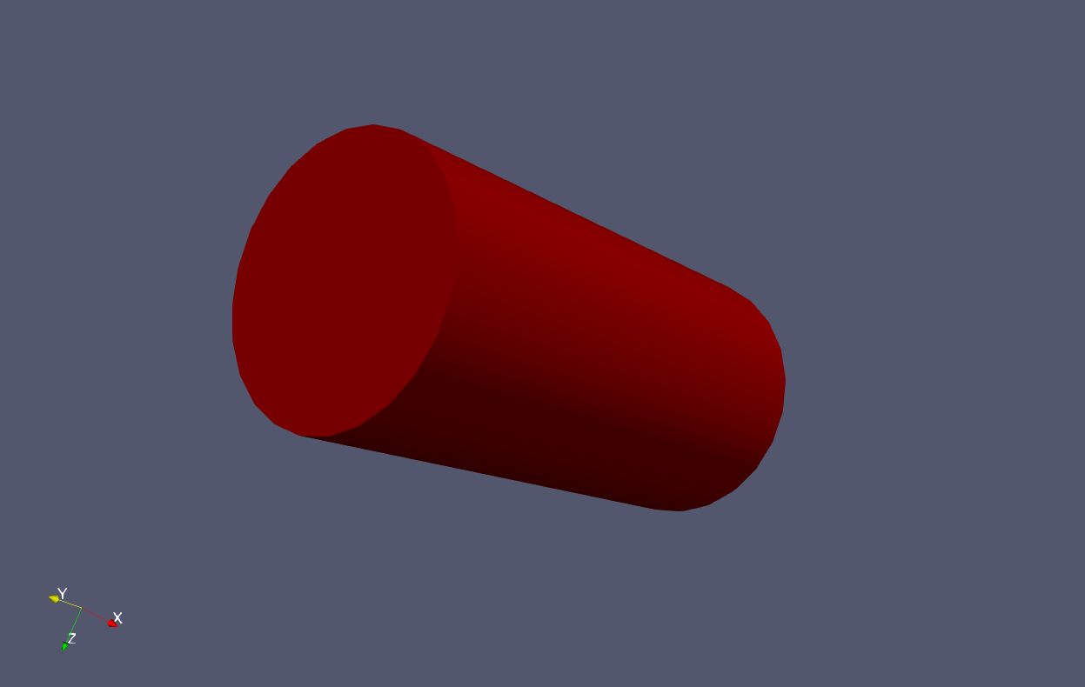
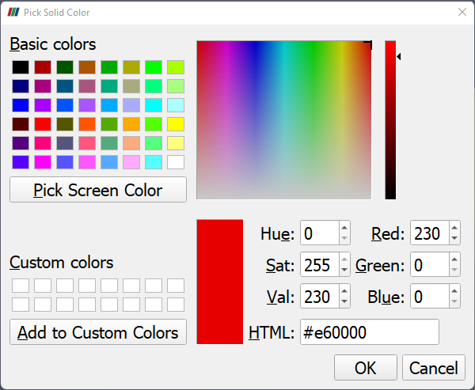
Color properties
All objects can be given colors either solid or by values / vectors

Slide 23
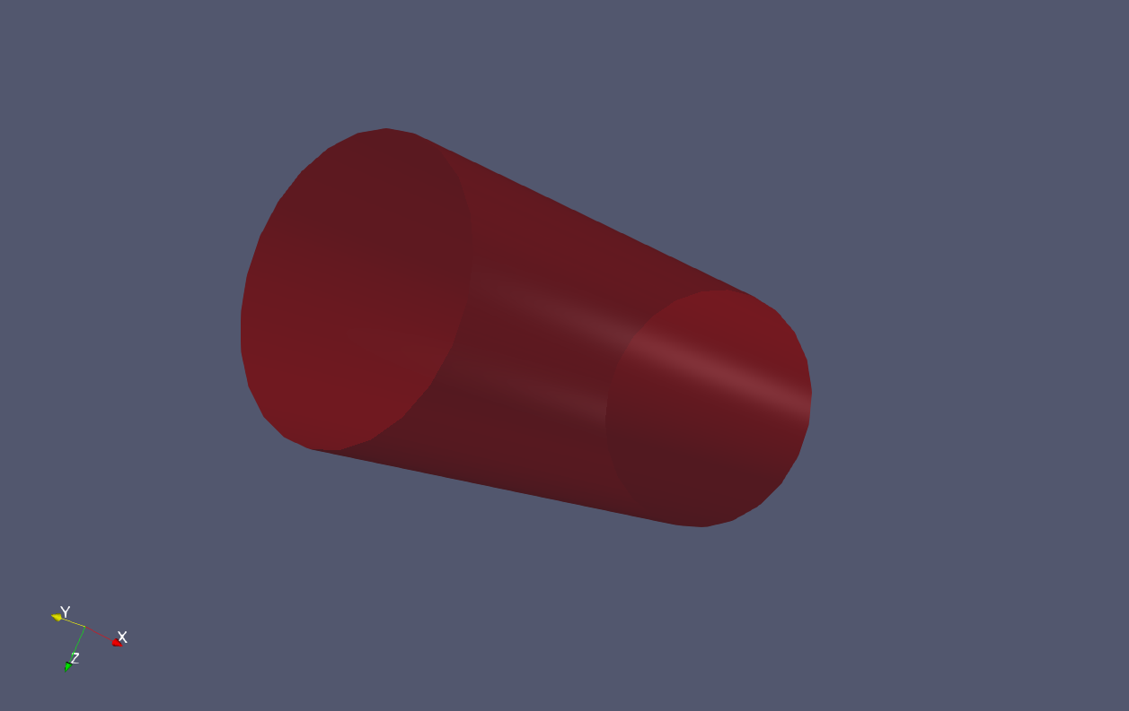
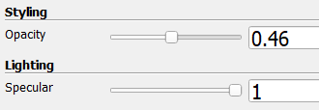
Material properties
Objects can also be given opacity and specular properties.
Specular controls how shiny an object is.
Opacity controls the transparency of an object. Can be useful to show outlines of objects.

Slide 24
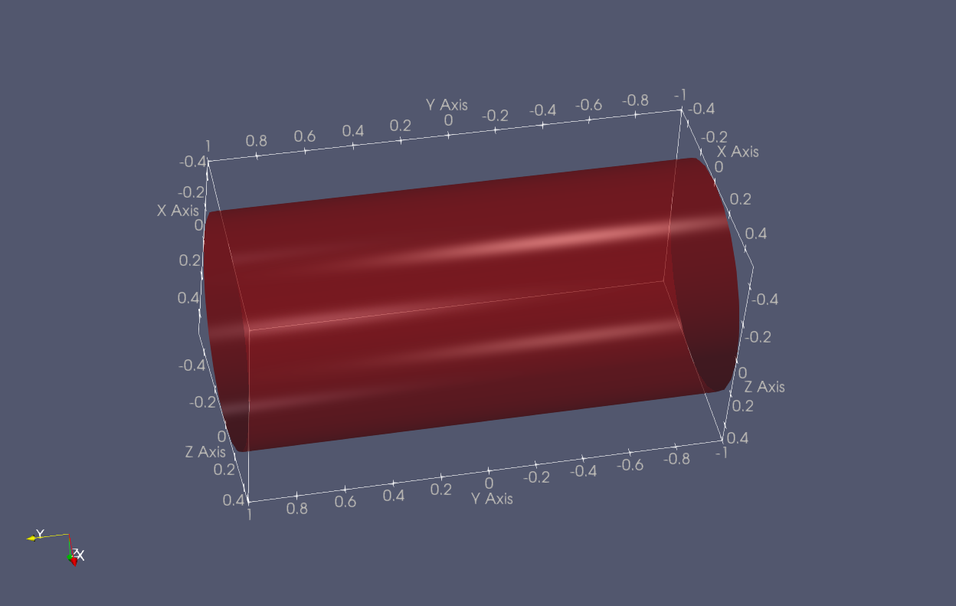
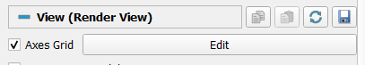
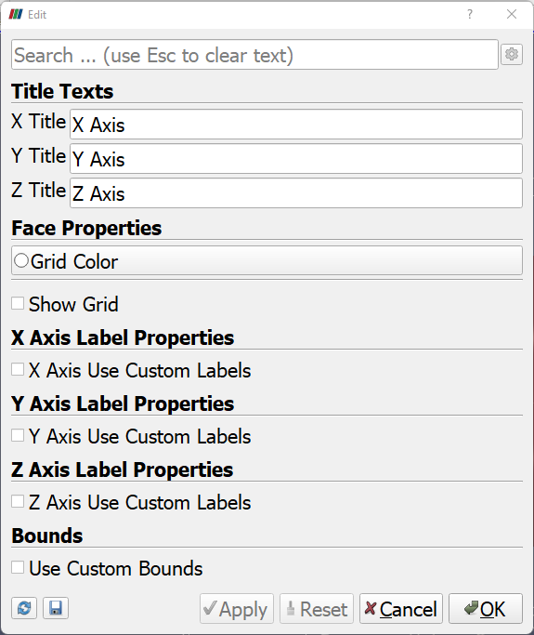
Axes
Axes can be used to give objects a sense of scale

Slide 25
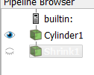
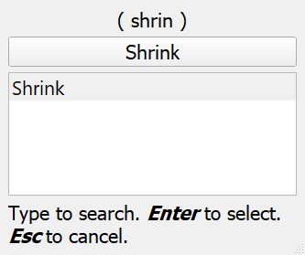
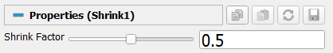
Applying a shrink filter
Click Filters / Search…
Type ”Shrink” in the search box
Press Enter or the button Shrink
Edit filter properties
Click Apply

Slide 26
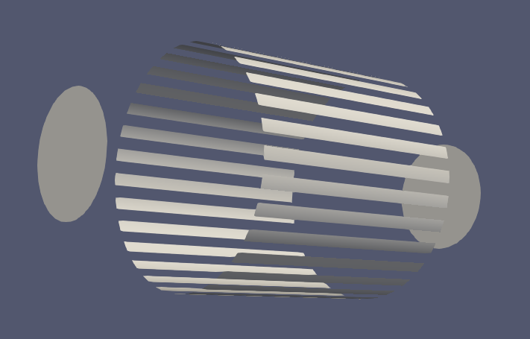
Applying a shrink filter
Colors, opacity and specular properties can be given for each separate object / filter

Slide 27
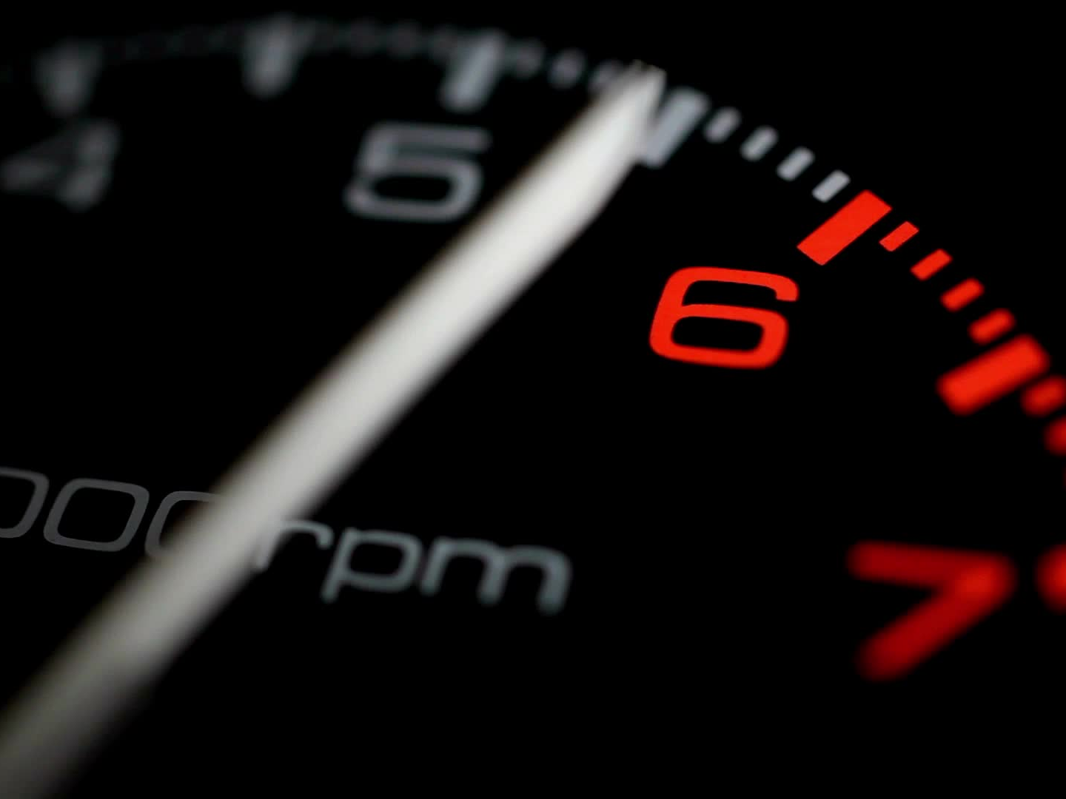
Demo time

Slide 28
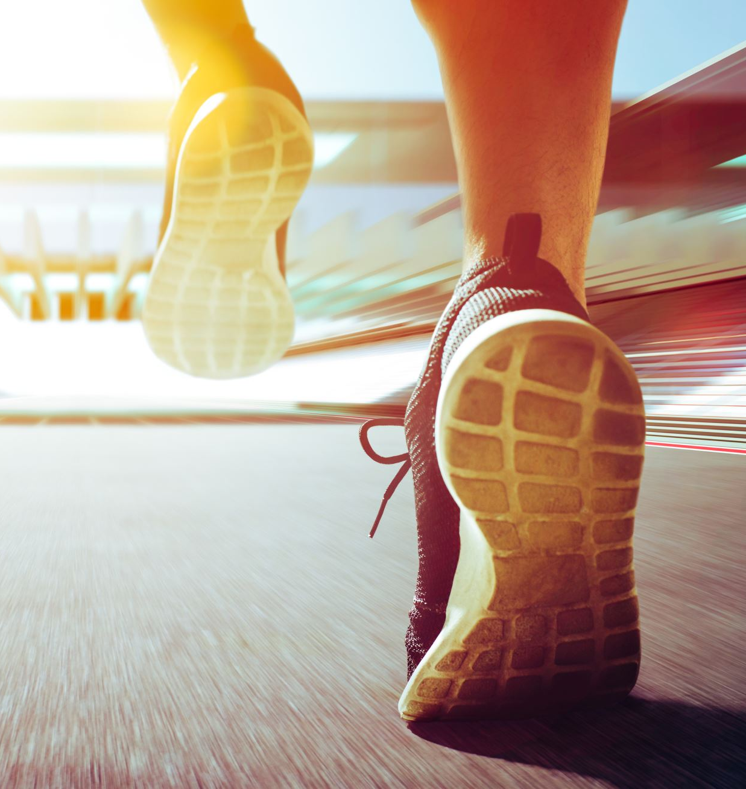
Exercise
Create a yellow sphere with a radius of 3.0 and a theta and phi resolution of 32. Make the sphere really shiny!
Apply a shrink filter with a shrink factor of 0.8.
Color the shrinked sphere green. It should also be shiny.

Slide 29
Reset ParaView

Slide 30

Reading scalar data

Slide 31
Open the scalar.csv file
X32,Y32,Z32,S
-1.00,-1.00,-1.00,0.00
-0.94,-1.00,-1.00,0.00
-0.87,-1.00,-1.00,0.00
-0.81,-1.00,-1.00,0.00
-0.74,-1.00,-1.00,0.00
-0.68,-1.00,-1.00,0.00
-0.61,-1.00,-1.00,0.00
-0.55,-1.00,-1.00,0.00
-0.48,-1.00,-1.00,0.00
-0.42,-1.00,-1.00,0.00
-0.35,-1.00,-1.00,0.00
-0.29,-1.00,-1.00,0.00
-0.23,-1.00,-1.00,0.00
-0.16,-1.00,-1.00,0.00
-0.10,-1.00,-1.00,0.00
-0.03,-1.00,-1.00,0.00
0.03,-1.00,-1.00,0.00
0.10,-1.00,-1.00,0.00
File/Open…
Find the scalar.csv file.
Click Apply to load the file

Slide 32
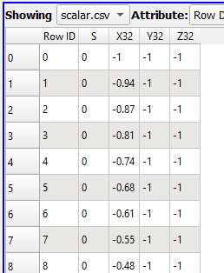
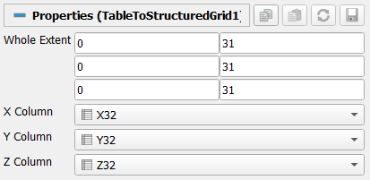
Reading CSV
We now need to translate this data into something that can be visualised with ParaView.
Todo this, we use the TableToStructureGrid filter.
Before applying the filter we need to define the structure of the data and where it can find the X, Y, Z coordinates in the files.

Slide 33
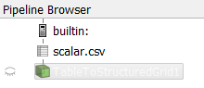

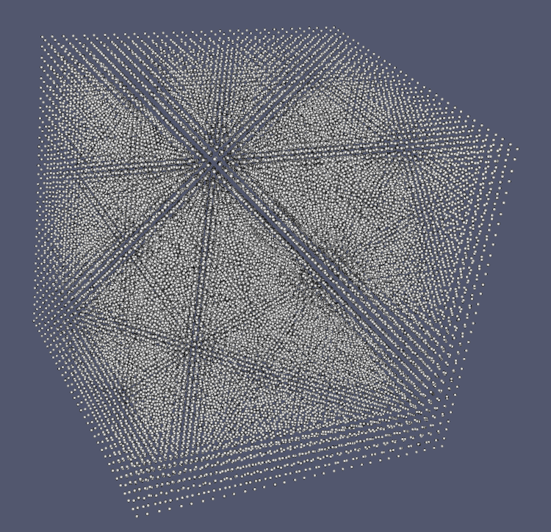
Visualising Scalar data
Click on the eye to display the data in the view.
Change the representation to Point Gaussian to display the values in the grid.
By default data is shown as an outline.

Slide 34
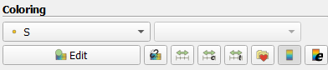
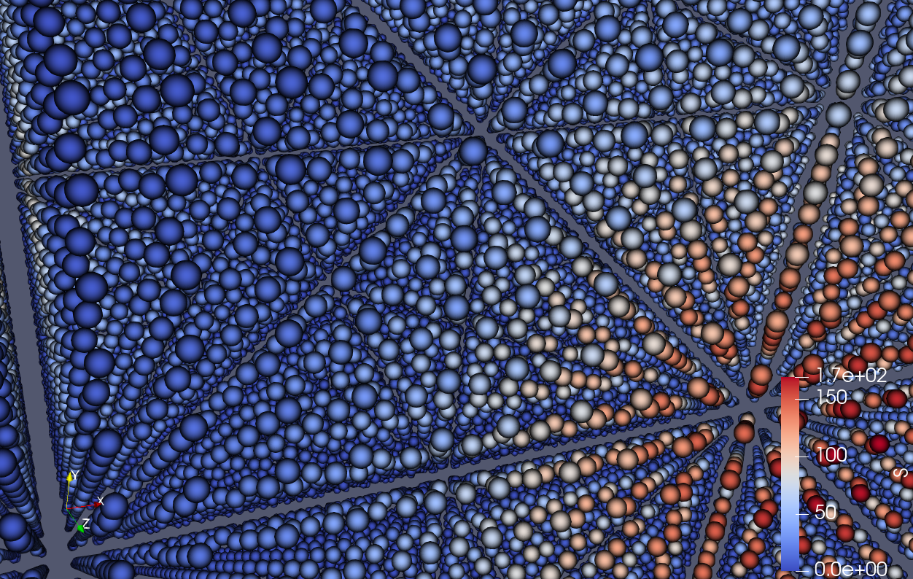
Displaying colors
The CSV file contained an S column of values. To display these using a color scale we need to select the data field in the Coloring section:

Slide 35
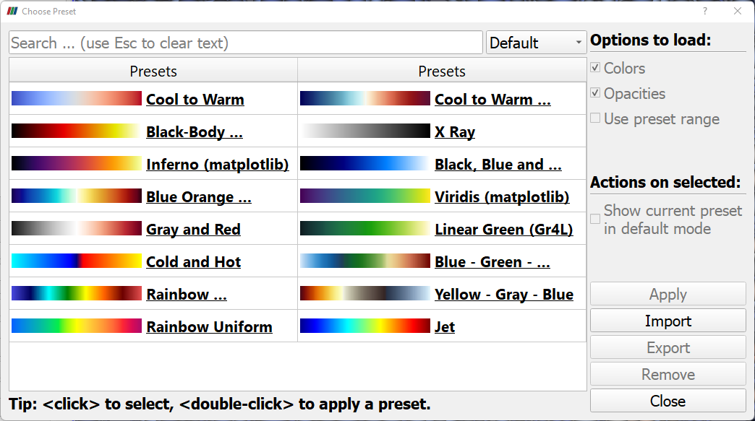
Changing color scale
Changing color scale can be done by selecting the folder with a heart.
A selection of color scales are displayed. Select a color map and click Apply to change.

Slide 36
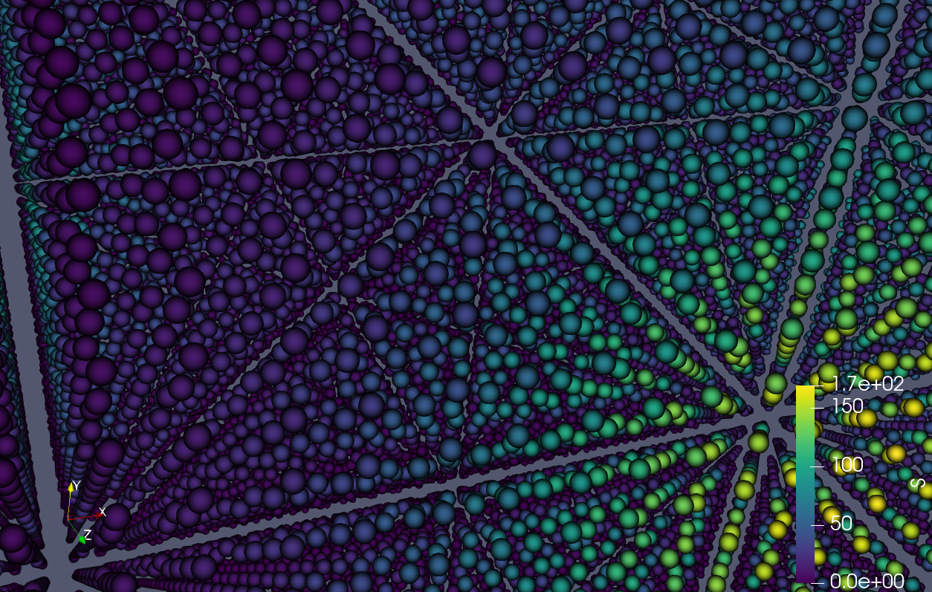
Changing color scale

Slide 37
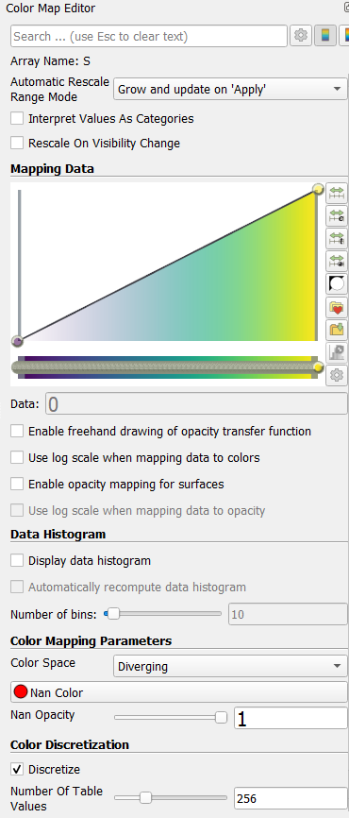
Changing color scale
The selected color scale can be edited by clicking the Edit button
Transparency transfer function
Color transfer function
A selection of color scales are displayed. Select a color map and click Apply to change.

Slide 38
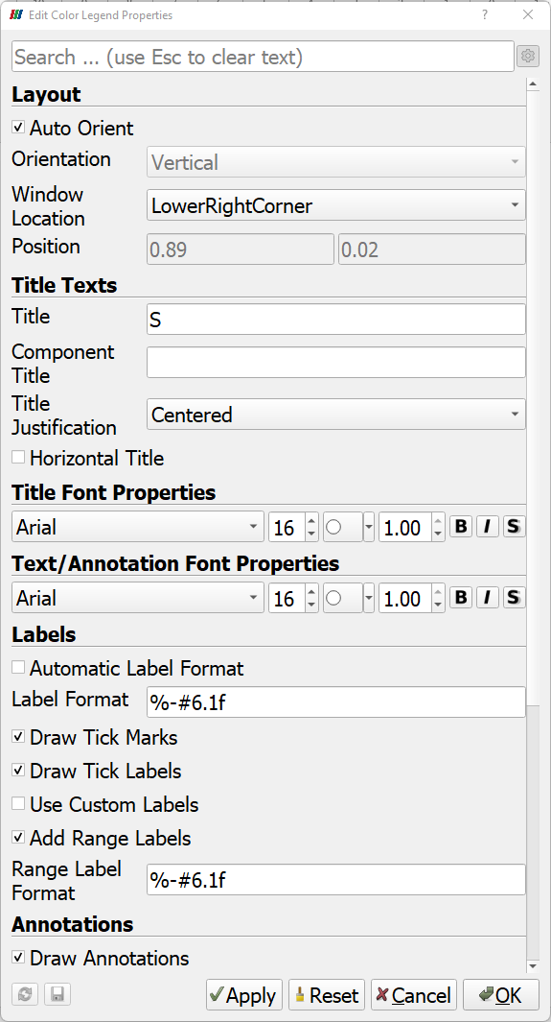
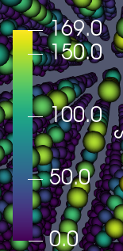
Changing the legend
Click the gear to show advanced options.
The color scale legend can be changed by selected the button with an e.
Setting the label format using format strings 6 characters wide with one decimal in fixed format.

Slide 39
Demo time

Slide 40
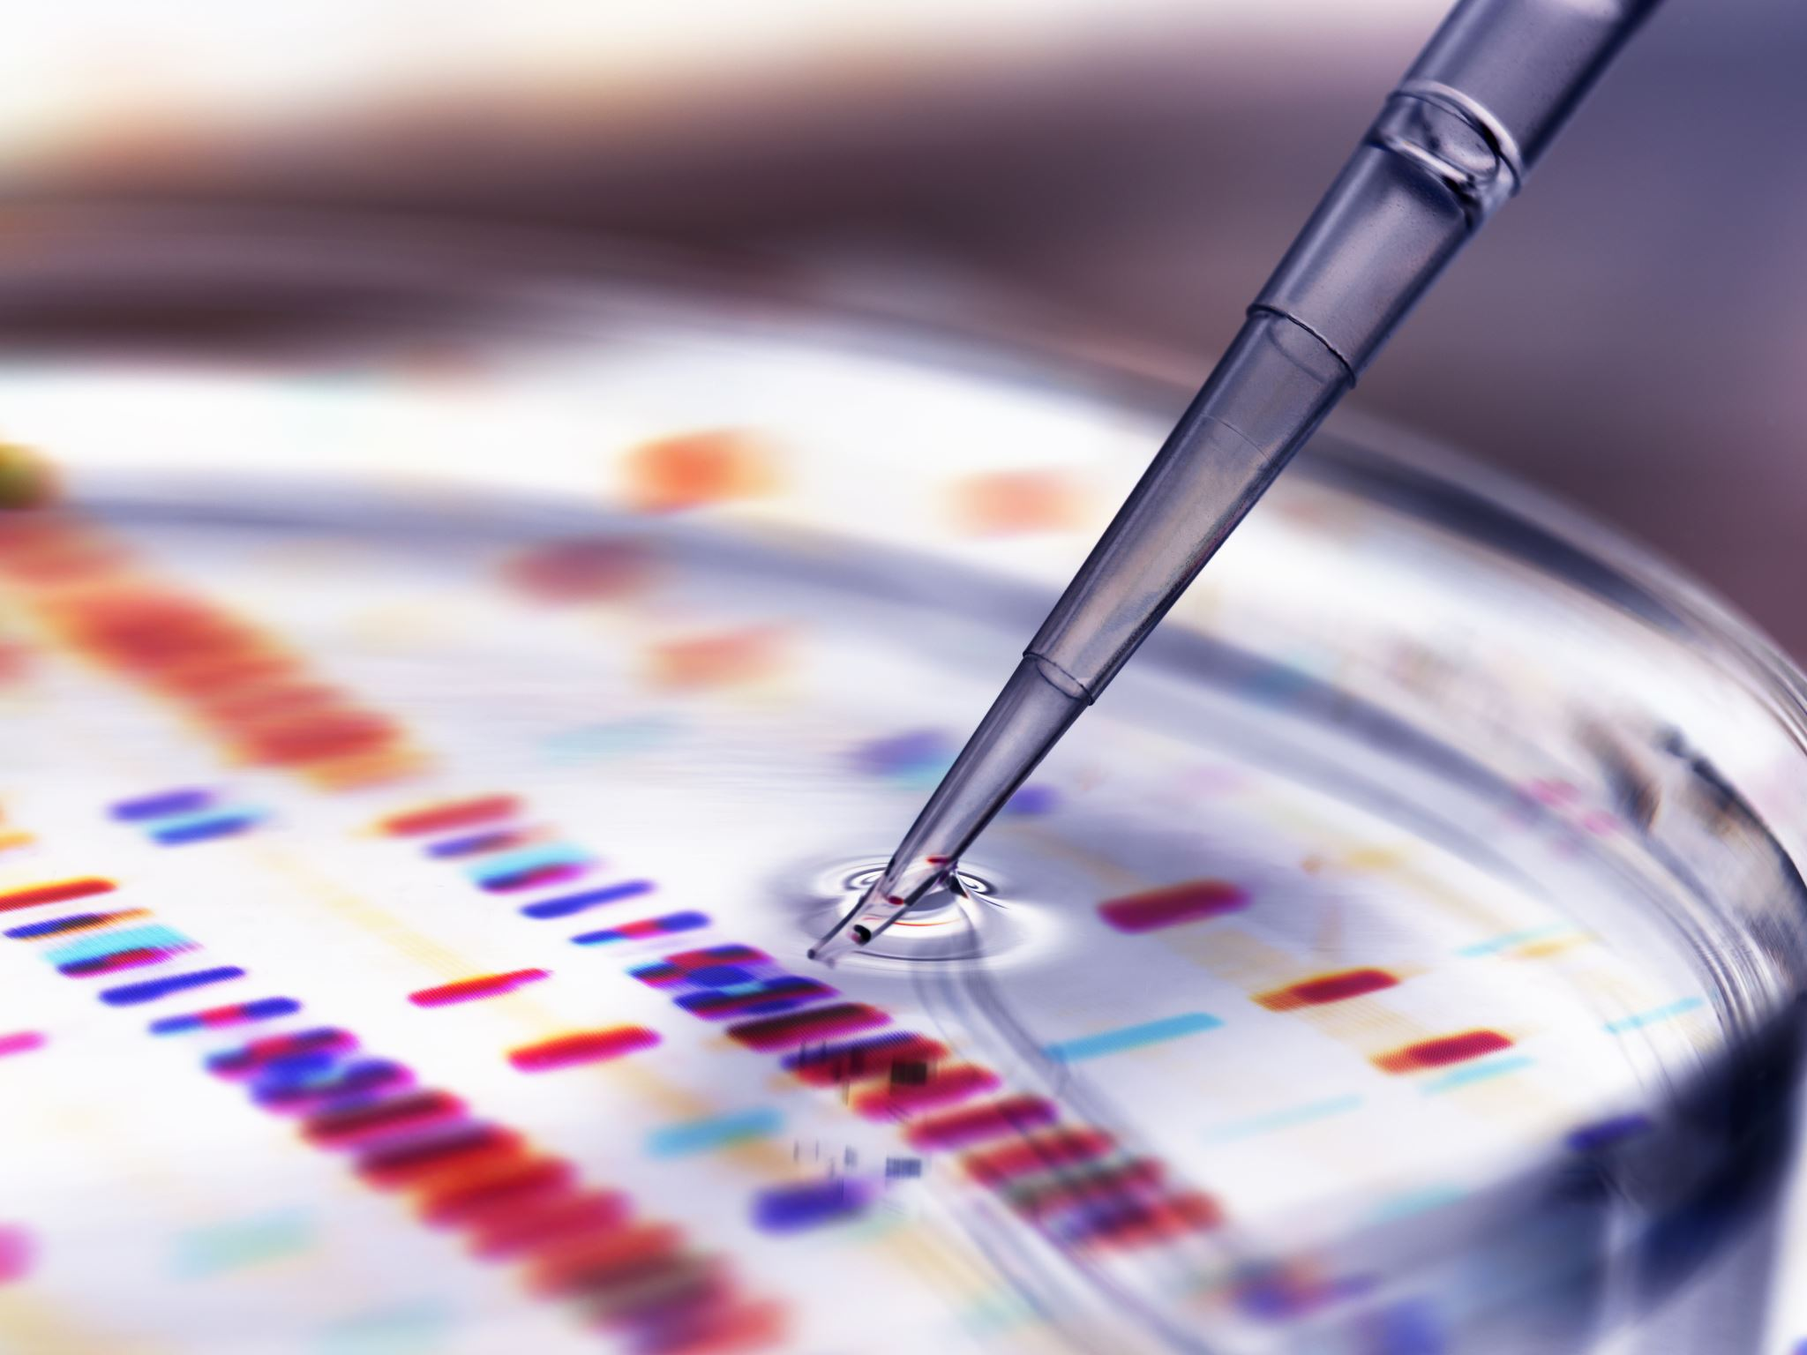
Using filters with scalar data

Slide 41

Common filters
Contour. Creates contour lines or surfaces.
Slice. Create a slice plane.
Threshold. Extracts data for a certain criteria
Glyph. Generate glyphs at data points
Warp by vector. Warps data mesh with a vector field
Calculator. Computes new fields based on existing fields.
Clip. Clips the data at a certain plane
Subset. Extracts a sub grid of the data
Stream tracer. Generate glyphs at data points

Slide 42




Glyph cloud
We need to turn off the TableToStructuredGrid

Slide 43
Demo time

Slide 44

Exercise
Play with the parameters to see how it affects the visualisation.

Slide 45



Tresholding data
We want to limit data in the glyph visualisation.
We Create the following pipeline
We use Delete to remote the existing filters and apply

Slide 46

Thresholding data

Slide 47


Creating a cutting plane
Move plane along normal
Delete all filters except the TablesToStructuredGrid
Set the filter representation to Outline
Add a Slice filter
The view shows a representation of the slice plane.
Rotate plane

Slide 48


Creating a cutting plane
Show a visual representation of the plane
Manual plane parameters
Make sure to color the plane according to the S field

Slide 49


Creating cutting plane

Slide 50

Displaying cutting planes with contours
Add a Contour filter
Show a visual representation of the plane
Add contour line
Remove contour line
Create multiple contour lines
Clear all contour lines

Slide 51


Displaying cutting planes with contours
Now we erase all existing contour lines
Create a range of contour lines
Click Generate and then Apply

Slide 52


Displaying cutting planes with contours
We can control the contour better by switching to a ”Wireframe” Representation
Line thickness

Slide 53


Displaying cutting planes with contours
Select the Slice filter and enable
This enables you to move the cutting planes displaying contours on the plane.

Slide 54



Displaying iso surfaces
Select TableToStructuredGrid1 and disable the other filters
Create a Contour filter from the grid
Notice that it is not possible to color the iso lines as S is not availble anymore.
We need a way of duplicating the S field

Slide 55


Displaying iso surfaces
Create a Calculator filter from the TableGrid
Name the result of the expression. We name it Scalar
We also need to move the Contour2 object after the Calculator filter.
Enter the expression here. In this case just return the scalar value from S

Slide 56



Displaying iso surfaces
Moving Contour2 after Calculator
Move here

Slide 57



Displaying iso surfaces
We can now select the computed field in the Contour filter

Slide 58


Displaying iso surfaces

Slide 59
Demo time

Slide 60

Exercise
Add 10 more iso surfaces in the visualisation. Add Axes to the plot.

Slide 61



Displaying data as a volume
Select TableToStructuredGrid1 and disable the other filters
Set representation to ”Volume”

Slide 62


Controlling the opacity properties
To better see structures in the volume the transparency transfer function can be modified.
Click
Add a point by clicking on the curve. Drag the point down to make values left of the point transparent

Slide 63




Creating iso volumes
Select TableToStructuredGrid1 and disable the other filters
Add a IsoVolume filter from the menu or searching for it

Slide 64



Creating smooth iso volumes
Add ExtractSurface and a GenerateNormals filter to the IsoVolume filter

Slide 65
Demo time

Slide 66
Reset ParaView

Slide 67
Reading vector data

Slide 68
Open the vector.csv file
X32,Y32,Z32,Vx,Vy,Vz
-1.00,-1.00,-1.00,2.00,2.00,2.00
-1.00,-1.00,-0.94,1.75,1.75,2.00
-1.00,-1.00,-0.87,1.53,1.53,2.00
-1.00,-1.00,-0.81,1.33,1.33,2.00
-1.00,-1.00,-0.74,1.15,1.15,2.00
-1.00,-1.00,-0.68,0.99,0.99,2.00
-1.00,-1.00,-0.61,0.84,0.84,2.00
-1.00,-1.00,-0.55,0.71,0.71,2.00
-1.00,-1.00,-0.48,0.60,0.60,2.00
-1.00,-1.00,-0.42,0.49,0.49,2.00
-1.00,-1.00,-0.35,0.40,0.40,2.00
-1.00,-1.00,-0.29,0.31,0.31,2.00
-1.00,-1.00,-0.23,0.24,0.24,2.00
-1.00,-1.00,-0.16,0.17,0.17,2.00
-1.00,-1.00,-0.10,0.10,0.10,2.00
-1.00,-1.00,-0.03,0.03,0.03,2.00
-1.00,-1.00,0.03,-0.03,-0.03,2.00
-1.00,-1.00,0.10,-0.10,-0.10,2.00
-1.00,-1.00,0.16,-0.17,-0.17,2.00
-1.00,-1.00,0.23,-0.24,-0.24,2.00
File/Open…
Find the vector.csv file.
Click Apply to load the file

Slide 69


Create a Grid from the data
Vector data from the CSV file is provided as 3 scalar fields.
We need to convert these to vectors
Calculator the the rescue

Slide 70


Combine scalar fields to vectors
iHat, jHat and kHat are unit vectors that can be used to create a vector field from scalar fields
We now have a vector field we can visualise. We start with glyphs

Slide 71
Demo time

Slide 72

Using filters with vector data

Slide 73




Visualise vectors using oriented glyps
Add a Glyph to the Calculator

Slide 74


Visualise vectors using oriented glyps
Sometimes it can be beneficial to visualise glyps as thin lines
Change representation to ”Line”

Slide 75




Visualise vectors stream tracer
Add a StreamTracer to the Calculator filter

Slide 76



Visualise vectors as ribbons
Add a Ribbon filter to the StreamTracer filter

Slide 77



Visualise vectors as tubes
Add a Tube filter to the StreamTracer filter

Slide 78
Demo time

Slide 79
Reset ParaView

Slide 80

Reading terrain data

Slide 81
Open the terrain.csv file
File/Open…
Find the terrain.csv file.
Click Apply to load the file
UTMx512,UTMy361,Z,Longitude,Latitude,Elevation
-6909.865,-6870.170,1174.991,-122.200,45.010,1174.991
-6882.896,-6870.356,1268.436,-122.198,45.010,1268.436
-6855.759,-6870.542,1308.478,-122.196,45.010,1308.478
-6828.789,-6870.728,1266.755,-122.193,45.010,1266.755
-6801.820,-6870.911,1203.239,-122.191,45.010,1203.239
-6774.682,-6871.095,1127.675,-122.189,45.010,1127.675
-6747.544,-6871.279,1074.388,-122.187,45.010,1074.388
-6720.575,-6871.461,1060.748,-122.185,45.010,1060.748
-6693.606,-6871.642,1056.135,-122.182,45.010,1056.135
-6666.468,-6871.823,1050.158,-122.180,45.010,1050.158

Slide 82

Visualising terrain data

Slide 83



Create a 2D grid from terrain data

Slide 84



Adjusting scale factor
Data is not square, so we need to adjust the scaling.
Add a Transform filter to the grid

Slide 85
Demo time

Slide 86

Exercise
Add a color scale for the elevation. Add contours to the terrain. Visualise them as black lines. Reduce the height exaggeration

Slide 87

Getting data into ParaView
Using PyVTK to read data into ParaView

Slide 88
Getting data into ParaView
ParaView supports a large amount of data formats.
In some cases you need to create your own export functions
The default fileformat format for ParaView is .vtk
.vtk-files are text files that can represent all data structures supported by VTK.
Complicated to create these manually
The PyVTK library can be used to simplify the creation of .vtk-files.

Slide 89

PyVTK Notebook
https://bit.ly/pyvtk-lecture

Slide 90

Exercises with real data

Slide 91


Photogrammetry
Open the skivarp.ply file.
Use the Calculator filter to create a scalar field, Z, with elevation data.
Visualise elevation data using a suitable color scale
Add black contour lines with a interval of 1 m

Slide 92
Structural Mechanics
Open the data..vtk (group)
The data files consists of several deflection modes (0-199) for a beam
Each mode consists of a vector field, displacements
Color the beam with the magnitude of the vectors.
Visualise the deflections using the Warp by Vector filter
Add axes to the model
Add a transparent outline of the beam by enabling the root vtk-object and using the opacity propery.
Browse through the deflection modes.

Slide 93

Cryo-EM
Open the .mrc file
Try using threshold to find interesting data in the data set.
Try a IsoVolume filter
Make a cut through the IsoVolume

Slide 94


CFD
Open the pipe.vtk file. Note this is a large data set and can take some time to load.
Visualise the flow field U
Using Glyphs
Stream Tracer
Stream Trace with Tubes.

Slide 95

Starting ParaView on Aurora

Slide 96


Slide 97

ParaView from LUNARC On-Demand
Give an estimate of how long you will need ParaView
Shows how much of the allocation have been used.
Start ParaView here

Slide 98


ParaView running on Aurora

Slide 99


Downloading data to Aurora
Download here

Slide 100


Downloading data to Aurora

Slide 101



Extracting data set

